Slide 1
GSP2203 Science, Technology and Society
TOPIC: Matter and its contents
Prepared by: Dr. Umar Sani

Slide 2
Science is a systematic enterprise that creates, builds and organizes knowledge in the form of testable explanations and predictions about the universe. Over the years, science has developed through a series of discoveries.

Slide 3
Scientists are very alert and inquisitive. They use their senses to observe what is happening around them. From a given set of observations, they see a pattern. This often leads to a problem which they try to solve. They put forward a reasonable explanation or hypothesis and carry out appropriate experiments to test it. Then they carefully record their observations and the results of their experiments. If the experiments support the hypothesis, they carry out further investigations. They discuss the hypothesis and results with other scientists in the field so that the hypothesis can be further tested.

Slide 4
When a hypothesis has been tested and found to be correct within the limits of available evidence, it becomes a theory. When a theory has been extensively tested and proven true without any exception, it becomes a law. If the experiments give negative results, then the scientist goes back to his hypothesis and either modifies it or puts forward a new theory.

Slide 6
Science can be broadly divided into two classes as natural science (study of natural phenomena) and social science (study of human behavior and societies)
Natural science includes Biology (study of living and non-living things),
Chemistry (study of composition, properties and uses of matter),
Physics (studies matter, its motion and behavior through space and time, and the related entities of energy and force),
Geography, etc
Social science includes: Psychology,
Sociology, etc

Slide 7
MATTER
Matter is anything that has mass and occupies space. By this definition, we see that almost everything in the universe is made up of matter. Examples of matter include the plants and animals around us, the food we eat, the water we drink and even the air we breathe.

Slide 8
Matter can exist in four different physical states
Solid state: Matter in this state has definite shape and definite volume. Examples include stone, book pen etc
Liquid state: Matter in liquid state has definite volume but no definite shape. It only takes the shapes of the container. Examples include water, petrol, juice, soup etc
Gaseous state: It has no definite shape and volume. Examples include: air, cooking gas, steam etc
Plasma state: it has no definite shape and volume but is ionized i.e consists of ions, and neutral particles. Examples include stars, flame, lightning etc

Slide 9
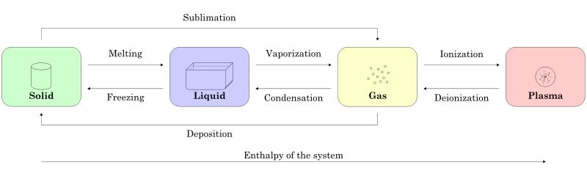
Matter in a particular state can change to another physical state as shown below:

Slide 10
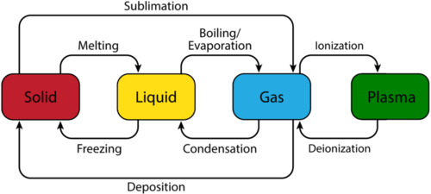

Slide 11
Example of melting: when ice changes to ice cold water
Example of freezing: Conversion of water to ice
Example of evaporation: Conversion of water to steam
Example of condensation: rainfall formation

Slide 12
PARTICULATE NATURE OF MATTER
Matter is made up of tiny particles. The main one is atom. The ancient Greeks were the first to use the word atom, which means indivisible, to describe the smallest particle of any substance. Its actual existence was not established until the nineteenth century when J. Dalton, an English Chemist, put forward a theory to describe the nature of the atom. The atom is now considered to be basic building blocks of matter.

Slide 13
J. Dalton proposed the atomic theory which was partially supported by experimental evidences but could not explain some scientific phenomena. As a result of new discoveries, Dalton’s theory has undergone several modifications but the principal aspects are still useful.
In about 1897, J, J. Thomson demonstrated the existence (inside the atom) of the electrons, a particle of matter with mass less than a thousandth of that of the lightest atom. This shows that atom is divisible
In 1911, British Physicist E, Rutherford showed that, an atom had internal structure which is extremely tiny, positively charged (a nucleus) around which a number of electrons go round it. It was also confirmed by J. J. Thomson that inside the nucleus there exist another particle called proton. In 1932, J. Chadwick discovered that the nucleus contained another particle called neutron, which has almost the same mass as the proton but no electrical charge. Following the discovery by Chadwick, the atom is made up of tiny nucleus containing protons and neutrons while the electrons are outside the nucleus.
In 1905, N. Bohr finally brought regularity in the study of atom. He conceived the model of electrons moving around the nucleus in circular imaginary lines called shells or orbits

Slide 14
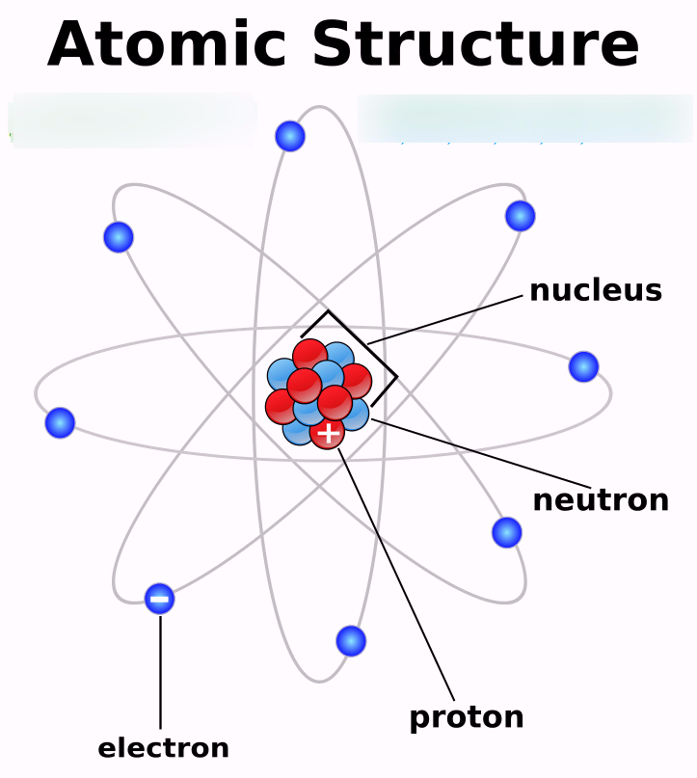

Slide 15
Changes in Matter
Matter can undergo two important changes. This can be either physical or chemical respectively. A physical change is one which is easily reversed and in which no new substances are formed. A few examples of physical changes are
Melting of ice
Freezing of liquids to solids
Writing with a pencil on a white paper
A chemical change is one which is not easily reversed and in which new substances are formed. A few examples of chemical changes include
Burning of wood
Decay of substances
Writing with biro on a white paper

Slide 16
Classification of Matter
Matter may be classified into elements, compounds and mixtures. An element is a substance which cannot be split into simpler units by an ordinary chemical process. Scientists have discovered over a hundred elements which include familiar ones like iron, hydrogen, oxygen, tin and iodine. They can be found in the Earth’s crust, in the air and in the sea. Some elements occur naturally while some are made artificially. Abbreviations or symbols are used to represent elements, example “O” for oxygen and “H” for hydrogen.

Slide 17
A compound is a substance which contains two or more elements chemically combined together. A compound is formed as a result of a chemical change. It is a new substance with entirely different properties from those of the substance(s) from which it was formed or its components. The component elements of a given compound are always present in a fixed ratio. For example, water is a compound formed from as a result of combination of hydrogen and oxygen in the ratio of 2:1. Other examples of compound include table salt (NaCl), sugar (C₁₂H₂₂O₁₁)

Slide 18
A mixture contains two or more constituents which can easily be separated by physical methods. The constituents may be elements or compounds or both. A mixture may be homogeneous if the constituents cannot be easily distinguished examples salt solution, milk, petroleum, soft drink etc. when the constituents of a mixture can easily be distinguished, the mixture is said to be a heterogeneous. Examples include muddy water, oil and water, freshly-squeezed orange etc some techniques are used to separate the components of mixtures.

