Slide 1
MODULE 6 :
FAMILY BUSINESS AND SUCCESSION PLANNING
Muazu Hassan Muazu
muazumuazu@gmail.co
Centre for African Entrepreneurship Research and Training , BUK
November, 2015

Slide 2
OBJECTIVE OF THE MODULE
To help students understand the concept of family business and the transition from family businesses to the mega firms we see today in the corporate world.

Slide 3
Family in the African and Nigerian settings
Uniquely African/Nigerian is the extended family system, and is defined as a multiplicity of primary familial relationship, usually determined by kinship, where everybody is a father, mother, brother, sister or child, which functions to meet the emotional, financial, physical and social needs of members

Slide 4
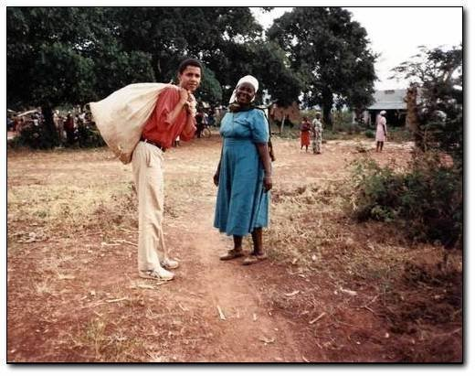
Remember and keep family background, trade & values

Slide 5
The concept of family business
A business owned by a family but run by non-family managers
A business owned by a large, multi-national corporation but run by a local family
A business jointly owned by two unrelated partners, each of whom has a son in the business

Slide 6
Assumptions on family business
Family Influenced Start-ups -Family influenced start-ups commonly occur and usually involve new business.
Family Corporate Venturing -This is like entrepreneurship within an established family business
Family corporate renewal
Provision of family private cash- Most new ventures are funded through family private cash.
Family Investment Funds -families may pool the excess fund for use in funding entrepreneurial actions of the family

Slide 7
Challenges of Family-Owned Businesses
Assuming that past success will guarantee their future success;
The legacy value attributed to the business does not translate into a market value or advantage;
Leaders try to balance the risk profile of their shareholders with the risk and investment demands of the marketplace;
Risk profiles differ between senior and successor generations;

Slide 8
Challenges
Hard to pass the responsibility of managing the firm into the hands of younger generations which they deem less capable;
Families build the first-generation business on the founder’s intuition, but then business never establishes more intentional entrepreneurial processes or confirmed strategy for the future to keep the entrepreneurial contributions alive;
Families rarely make use of the same financial strategies as those used by fellow entrepreneurs to grow the business;
Families do not get rid of unproductive assets and underperforming businesses to reallocate resources to more productive places;

Slide 9
Challenges cont……
Successor generation family members feel entitled to get a business rather than seek next-generation entrepreneurial opportunity;
Senior leaser communicate to the next generation that business planning and entrepreneurial analysis is a waste of time;
The family member is given part of the business to run as part of their legacy, and this is deemed to be entrepreneurship in the family.

Slide 10
Further Challenges
Lack of an exit strategy;
Succession planning;
High turnover of non-family members;
Lack of training of new family members who join the business;
Lack of outside opinions and diversity on how to operate the business.

Slide 11
Cultural Context
Value of Community Life
Value of Family oneness
Value of the Sacred and Religion
Value of old age and authority
Value of Acceptance and Hospitality

Slide 12
Advantages of a Family Business
Strength of family relationships
Financial sacrifices for the good of the firm
Operation as a family business makes it unique
Concern for its community and non-family employees
Capability to plan and prepare for the long haul
Emphasis on quality and value

Slide 13
Disadvantages of a Family Business
Conflict among family members may result in:
Risk (consequences of failure) to the family in launching a business
Nepotism and the differences in competencies and merit of family members involved in the business

Slide 14
Disadvantages cont......
Family traditions versus the business need to innovate and seize opportunities
Unity and cooperation of family versus business need to foster diversity and
competition
Family loyalty versus the necessity to provide opportunities for non-family
employees

Slide 15
The way forward
Strategies for reducing the challenges faced by family businesses:
  Family retreats - A gathering of family members, usually at a remote location, to discuss family business matters
  Family Council - An organized group of family members (councils) who gather periodically to discuss family-related business issues
  Family Business Constitution - A memorandum of associations

Slide 16
Succession Planning
Succession, in organizations, refers to the process of transferring managerial control from one leader or one generation of leaders to the next
In the context of family business, Sharma et al (2001) define succession as the actions and events that lead to the transition of leadership from one family member to another

Slide 17
Succession Planning cont….
Entrepreneurial succession is the process by which ownership and control of the production or commercial infrastructure accumulated by one generation of a nuclear or extended family is transferred to the next.
It entails the transfer of a commercial investment of any type from the owner-founder to his prospective survivors.

Slide 18
Beneficiaries of Family Businesses
These could be members of a nuclear family in a monogamous household or members of a compound family in a polygamous household,
Survivors could also be members of the extended family such as uncles, aunts, nephews, nieces, cousins etc

Slide 19
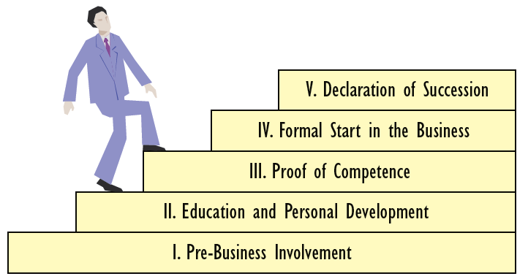
Stages of the Succession Process in a Family Business

Slide 20

Thank You

