Slide 1

The process of Decision Analysis
Baba Maiyaki Musa
MBBS MPH FWACP

Slide 2
At the end of this module the student will be able to :
describe a nonclinical work-related decision.
Describe who makes the decision, what actions are possible, what the resulting
outcomes are, and how these outcomes are evaluated:
He would also appreciate :
  1. Who makes the decision?
  2. What actions are possible (list at least two actions)?
  3. What are the possible outcomes?
  4. Besides cost, what other values enter these decision?
  5. Whose values are considered relevant to the decision?
  6. Why are the outcomes uncertain?

Slide 3
Any time a selection must be made among alternatives, a decision is
being made, and it is the role of the analyst to assist in the decision-making process.
When decisions are complicated and require careful consideration
and systematic review of the available options, the analyst’s role
becomes paramount.
An analyst needs to ask questions to understand :
  who the decision makers are,
  what they value,
  and what complicates the decision.
The analyst deconstructs complex decisions into component parts and
then reconstitutes the final decision from those parts using a mathematical model.
In the process, the analyst helps the decision maker think through the decision

Slide 4
Some decisions are harder to make than others.
For instance, some problems are poorly articulated. In other cases, the causes and effects of potential actions are uncertain.
There may be confusion about what events could affect the decision.
Decision analysis provides:
  structure to the problems a manager faces,
  reduces uncertainty about potential future events,
  helps decision makers clarify their values and preferences,
  and reduces conflict among decision makers who may have different opinions about the utility of various options.

Slide 5
We would outline the steps involved in decision analysis,
Including
  exploring problems
  clarifying goals,
  identifying decision makers,
  structuring problems,
  quantifying values and uncertainties,
  analyzing courses of action,
  and finally recommending the best course of action.
This module provides a foundation for understanding the purpose and process of decision analysis.

Slide 6
Who Is a Decision Maker?
The decision maker receives the findings of the analysis and uses them to make the final decision.
One of the first tasks of an analyst is to clarify who the decision makers are and what their timetable is.

Slide 7
Throughout the book, the assumption is that at least one decision
maker is always available to the analyst.
This is an oversimplification of the reality of organizations. Sometimes it is not clear who the decision maker is. Other times, an analysis starts with one decision maker who then leaves her position midway through the analysis; one person commissions the
analysis and another person receives the findings.
Sometimes an analyst is asked to conduct an analysis from a societal perspective, where it is difficult to clearly identify the decision makers.
All of these variations make the process of analysis more difficult.

Slide 8
What Is a Decision?
This module is about using analytical models to find solutions to complex
decisions.
. Most individuals go through their daily work without making any decisions.
They react to events without taking the time to think about them. When the phone rings, they automatically answer it if they are available. In these situations, they are not deciding but just working.
Sometimes, however, they need to make decisions. If they have to hire someone and there are many applicants, they need to
make a decision.
One situation is making a decision as opposed to following a routine.

Slide 9
To make a decision is to arrive at a final solution after
consideration, ending dispute about what to do.
A decision is made when a course of action is selected among alternatives.
A decision has the following
five components:
  1. Multiple alternatives or options are available.
  2. Each alternative leads to a series of consequences.
  3. The decision maker is uncertain about what might happen.
  4. The decision maker has different preferences about outcomes associated with various consequences.
  5. A decision involves choosing among uncertain outcomes with different values.

Slide 10
What Is Decision Analysis?
Analysis is defined as the separation of a whole into its component parts.
Decision analysis is the process of separating a complex decision into its component parts and using a mathematical formula to reconstitute the whole decision from its parts.
It is a method of helping decision makers choose the best alternative by thinking through the decision maker’s preferences and values and by restructuring complex problems into simple ones.
An analyst typically makes a mathematical model of the decision.

Slide 11
What Is a Model?
A model is an abstraction of the events an relationships influencing a decision.
It usually involves a mathematical formula relating the various concepts together.
The relationships in the model are usually quantified using numbers.
A model tracks the relationship among various parts of a decision and helps the decision maker see the whole picture.

Slide 12
What Are Values?
A decision maker’s values are his priorities.
A decision involves multiple outcomes and, based on the decision maker’s perspective, the relative worth of these outcomes would be different.
Values show the relative desirability of the various courses of action in the eyes of the decision maker.
Values have two sides: cost and benefits.

Slide 13
Cost is typically measured
in dollars and may appear straightforward. However, true costs are complex measures that are difficult to quantify because certain costs, such as loss of goodwill, are nonmonetary and not easily tracked in budgets.
Furthermore, monetary costs may be difficult to allocate to specific operations
as overhead, and other shared costs may have to be divided in methods that seem arbitrary and imprecise.

Slide 14
Benefits need to be measured on the basis of various constituencies’ preferences.
Assuming that benefits and the values associated with them are unquantifiable can be a major pitfall.
Benefits should not be subservient to cost, because values associated with benefits often drive the actual decision.
By assuming that values cannot be quantified, the analysis may ignore concerns most likely to influence the decision maker.

Slide 15
An Example
A hypothetical situation faced by the head of the state agency responsible for evaluating nursing home quality can demonstrate the use of decision analysis.
A nursing home has been overmedicating its residents in an effort to restrain them, and the administrator of the state agency must take action to improve care at the home.
The possible actions include fining the home, prohibiting admissions, and teaching the home personnel how to appropriately use psychotropic drugs.

Slide 16
Any real-world decision has many different effects. For instance, the
state could institute a training program to help the home improve its use
of psychotropic drugs, but the state’s action could have effects beyond
changing this home’s drug utilization practices.
The nursing home could become more careful about other aspects of its care, such as how it plans care for its patients. Or the nursing home industry as a whole could become convinced that the state is enforcing stricter regulations on the administration of psychotropic drugs.
Both of these effects are important dimensions that should be considered during the analysis and in any assessment performed afterward.

Slide 17
The problem becomes more complex because the agency administrators must consider which constituencies’ values should be taken into account and what their values are regarding the proposed actions.
For example, the administrator may want the state to portray a tougher image to the nursing home industry, but one constituent, the chairman of an important legislative committee, may object to this image.
Therefore, the choice of action will depend on which constituencies’ values are considered and how much importance each constituency is assigned.

Slide 18
Prototypes for Decision Analysis
Real decisions are complex. Analysis does not model a decision in all its
complexity.
Some aspects of the decision are ignored and not considered
fundamental to the choice at hand.
The goal is not to impress, and in the process overwhelm, the decision maker with the analyst’s ability to capture all possibilities. Rather, the goal of analysis is to simplify the decision enoughto meet the decision maker’s needs.
An important challenge, then, is to determine how to simplify an analysis without diminishing its usefulness and accuracy.
When an analyst faces a decision with interrelated events, a
tool called a decision tree might be useful.

Slide 19
Over the years, as analysts have applied various tools to simplify and model decisions, some prototypes have emerged.
If an analyst can recognize that a decision is like one of the prototypes in her arsenal of solutions, then she can quickly address the problem.
Each prototype leads to some simplification of the problem and a specific analytical solution.
The existence of these prototypes helps in addressing the problem with known tools
and methods.

Slide 20
Following are five of these prototypes:
1. The unstructured problem
2. Uncertainty about future events
3. Unclear values
4. Potential conflict
5. The need to do it all

Slide 21
Prototype 1: The Unstructured Problem
Sometimes decision makers do not truly understand the problem they are
addressing. This lack of understanding can manifest itself in disagreements
about the proper course of action.
The members of a decision-making team may prefer different reasonable actions based on their limited perspectives
of the issue.
In this prototype, the problem needs to be structured so the decision makers understand all of the various considerations involved in
the decision.
An analyst can promote better understanding of the decision
by helping policy makers to explicitly identify the following:

Slide 22
Individual assumptions about the problem and its causes
• Objectives being pursued by each decision maker
• Different perceptions and values of the constituencies
• Available options
• Events that influence the desirability of various outcomes
• Principal uncertainties about future outcomes

Slide 23
A good way to structure the problem is for the analyst to listen to the decision maker’s description of various aspects of the problem.
the analyst usually seeks to understand the nature of the problem by clarifying the values and uncertainties involved.
When the problem is fully described, the analyst can provide an organized summary to the decision makers, helping them see the whole and its parts.

Slide 24
Prototype 2: Uncertainty About Future Events
Decision makers are sometimes not sure what will happen if an action is taken, and they may not be sure about the state of their environment.
For example, what is the chance that initiating a fine will really change the way the nursing home uses psychotropic drugs? What is the chance that a hospital administrator opens a stroke unit and competitors do the same?
In this prototype, the analyst needs to reduce the decision maker’s uncertainty.

Slide 25
In the nursing home example, there were probably some clues about whether the nursing home’s overmedication was caused by ignorance or greed.
However, the clues are neither equally important nor measured on a common scale. The analyst helps to compress the clues to a single scale for comparison.
The analyst can use the various clues to clarify the reason for the use of psychotropic drugs and thus help the decision maker choose between a punitive course of action or an educational course of action.

Slide 26
Some clues suggest that the target event (e.g., eliminating the overmedication of nursing home patients) might occur, and other clues suggest the opposite.
The analyst must distill the implications of these contradictory clues into a single forecast.
Deciding on the nature and relative importance of these clues is difficult, because people tend to assess complex uncertainties poorly unless they can divide them into manageable components.
Decision analysis can help make this division by using probability
models that combine components after their individual contributions have been determined.

Slide 27
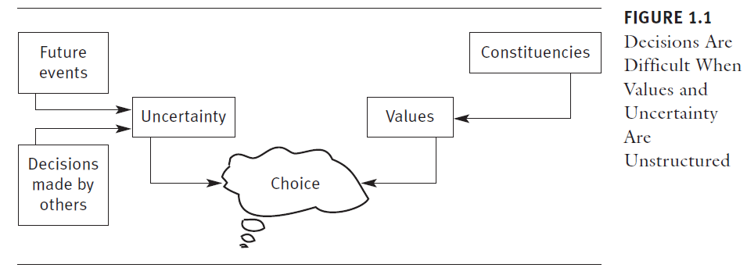
Prototype 3: Unclear Values
In some situations, the options and future outcomes are clearly identified,
and uncertainty plays a minor role. However, the values influencing the

Slide 28
options and outcomes might be unclear.
A value is the decision maker’s judgment of the relative worth or importance of something.
Even if there is a single decision maker, it is sometimes important to clarify his priorities and values.

Slide 29
The decision maker’s actions will have many outcomes, some of which are positive and others negative.
One option may be preferable on one dimension but unacceptable on another.
The decision maker must trade off the gains in one dimension with losses in another.

Slide 30
In traditional attempts to debate options, advocates of one option
focus on the dimensions that show it having a favorable outcome, while opponents attack it on dimensions on which it performs poorly.
The decision maker listens to both sides but has to make up her own mind.
Optimally, a decision analysis provides a mechanism to force consideration of all dimensions, a task that requires answers to the following questions:
  • Which objectives are paramount?
  • How can an option’s performance on a wide range of measurement
  scales be collapsed into an overall measure of relative value?

Slide 31
For example, a common value problem is how to allocate limited
resources to various individuals or options.
The British National Health Service, which has a fixed budget, deals with this issue quite directly.
Some money is allocated to hip replacement, some to community health services, and some to long-term institutional care for the elderly.
Many people who request a service after the money has run out must wait until the next year.
Similarly, a CEO has to trade off various projects in different departments
and decide on the budget allocation for the unit.
The decision analysis approach to these questions uses multi-attribute value (MAV) modeling

Slide 32
Prototype 4: Potential Conflict
In this prototype, an analyst needs to help decision makers better understand conflict by modeling the uncertainties and values that different constituencies see in the same decision.
Common sense tells us that people with different values tend to choose different options,
The principal challenges facing a decision-making team may be understanding how different constituencies view and value a problem and determining what trade-offs will lead to a win-win, instead of a win-lose, solution.
Decision analysis addresses situations like this by developing an MAV model
for each constituency and by using these models to generate new options that are mutually

Slide 33
Consider, for example, a contract between a health maintenance
organization (HMO) and a clinician.
The contract will have many components.
The parties will need to make decisions on cost, benefits, professional
independence, required practice patterns, and other such issues.
The HMO representatives and the clinician have different values and preferred outcomes. An analyst can identify the issues and highlight the values and preferences of the parties.
The conflict can then be understood, and steps can be taken to avoid escalation of conflict to a level that disrupts the negotiations.

Slide 34
Prototype 5: The Need to Do it All
Of course, a decision can have all of the elements of the last four prototypes.
In these circumstances, the analyst must use a number of different
tools and integrate them into a seamless analysis.
Figure 1.3 shows the multiple components of a decision that an analyst
must consider when working in this prototype.
An example of this prototype is a decision about a merger between
two hospitals. There are many decision makers, all of whom have different
values and none of whom fully understand the nature of the problem.
There are numerous actions leading to outcomes that are positive on some levels
and negative on others.
There are many uncertain consequences associated with the merger that could affect the different outcomes, and the outcomes do not have equal value. In this example, the decision analyst needs to address all of these issues before recommending a course of action.

Slide 35
Steps in Decision Analysis
Good analysis is about the process, not the end results. It is about the people,
not the numbers. It uses numbers to track ideas.

Slide 36
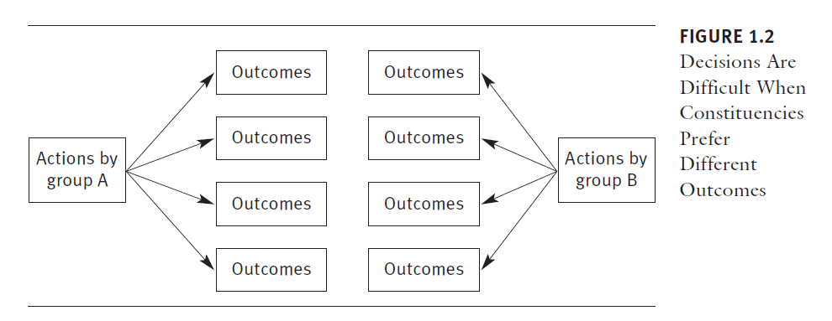

Slide 37
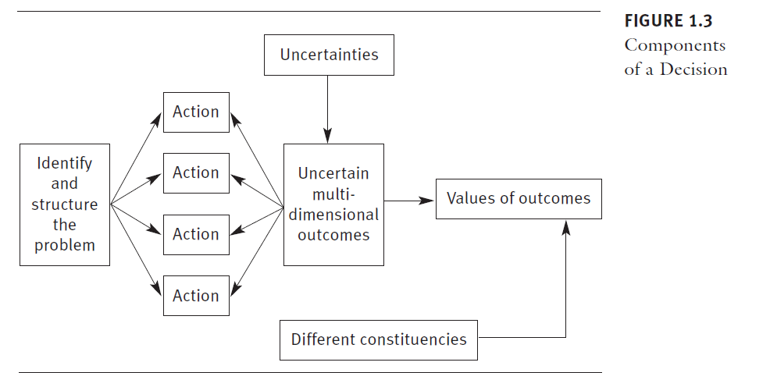

Slide 38
. One way to analyze a decision is for the analyst to conduct an independent analysis and present the results to the decision maker in a brief paper.
This method is usually not very helpful to the decision maker, however, because it emphasizes the findings as opposed to the process.
Decision makers are more likely to accept an analysis in which they have actively participated.

Slide 39
The preferred method is to conduct decision analysis as a series of increasingly sophisticated interactions with the decision maker.
At each interaction, the analyst listens and summarizes what the decision maker says.
In each step, the problem is structured and an analytical model is created.
Through these cycles, the decision maker is guided to his own conclusions, which the analysis documents.

Slide 40
Whether the analysis is done for one decision maker or for many, there are several distinct steps in decision analysis.
A number of investigators have suggested steps in conducting decision analysis (Soto 2002; Philips
et al. 2004; Weinstein et al. 2003).
Soto (2002), working in the context of clinical decision analysis, recommends that all analyses should take the following 13 steps:

Slide 41
1. Clearly state the aim and the hypothesis of the model.
2. Provide the rationale of the modeling.
3. Describe the design and structure of the model.
4. Expound the analytical time horizon chosen.
5. Specify the perspective chosen and the target decision makers.
6. Describe the alternatives under evaluation.
7. State entirely the data sources used in the model.
8. Report outcomes and the probability that they occur.
9. Describe medical care utilization of each alternative.
10. Present the analyses performed and report the results.
11. Carry out sensitivity analysis.
12. Discuss the results and raise the conclusions of the study.
13. Declare a disclosure of relationships.

Slide 42
Step 1: Identify Decision Makers, Constituencies, Perspectives, and Time Frames
Who makes the decision is not always clear. Some decisions are made in
groups, others by individuals.
For some decisions, there is a definite deadline; for others, there is no clear time frame. Some decisions have already been made before the analyst comes on board; other decisions involve much uncertainty that the analyst needs to sort out.
Sometimes the person who sponsors the analysis is preparing a report for a decision-making body that is not available to the analyst. Other times, the analyst is in direct contact with the decision maker. Decision makers may also differ in the perspective they want the analysis to take. Sometimes providers’ costs and utilities are central; other times, patients’ values drive the analysis.
Sometimes societal perspective is adopted; other times, the problem is analyzed from the perspective of a company. Decision analysis can help in all of these situations, but in each of them the analyst should explicitly specify the decision makers, the perspective of the analysis, and the time frame for the decision.

Slide 43
It is also important to identify and understand the constituencies,
whose ideas and values must be present in the model. A decision analyst can always assume that only one constituency exists and that disagreements arise primarily from misunderstandings of the problem rather than from
different value systems among the various constituencies.
But when several constituencies have different assumptions and values, the analyst must examine the problem from the perspective of each constituency.

Slide 44
A choice must also be made about who will provide input into the
decision analysis. Who will specify the options, outcomes, and uncertainties? Who will estimate values and probabilities? Will outside experts be called in? Which constituencies will be involved? Will members of the decision- making team provide judgments independently, or will they work as a team to identify and explore differences of opinion?
Obviously, all of these choices depend on the decision, and an analyst should simply ask questions and not supply answers.

Slide 45
Step 2: Explore the Problem and the Role of the Model
Problem exploration is the process of understanding why the decision maker wants to solve a problem. The analyst needs to understand what the resolution of the problem is intended to achieve.
This understanding is crucial because it helps identify creative options for action and sets some criteria for evaluating the decision.
The analyst also needs to clarify the purpose of
the modeling effort.

Slide 46
• The purpose might be to keep track of ideas,
have a mathematical formula that can replace the decision maker in
repetitive decisions,
• clarify issues to the decision maker,
• help others understand why the decision maker chose a course of
action,
• document the decision,
• help the decision maker arrive at self-insight,
• clarify values, or
• reduce uncertainty.

Slide 47
Let’s return to the earlier example of the nursing home that was
restraining its residents with excessive medication.
The problem exploration might begin by understanding the problem statement:
“Excessive use of drugs to restrain residents.” Although this type of statement is often taken at face value, several questions could be asked: How should nursing home residents behave? What does “restraint” mean? Why must residents be restrained? Why are drugs used at all? When are drugs appropriate, and when are they not appropriate? What other alternatives does a nursing home
have to deal with problem behavior?

Slide 48
The questions at this stage are directed at (1) helping to understand
the objective of an organization,
(2) defining frequently misunderstood
terms,
(3) clarifying the practices causing the problem, (4) understanding the reasons for the practice,
(5) separating desirable from undesirableaspects of the practice.

Slide 49
During this step, the decision analyst must determine which ends, or objectives, will be achieved by solving the problem.
In the example, the decision analyst must determine whether the goal is primarily to
  1. protect an individual patient without changing overall methods in the nursing home;
  2. correct a problem facing several patients (in other words, change the home’s general practices); or
  3. correct a problem that appears to be industry-wide.

Slide 50
Once these questions have been answered, the decision analyst and decision maker will have a much better grasp on the problem.
The selectedobjective will significantly affect both the type of actions considered and the particular action selected.

Slide 51
Step 3: Structure the Problem
Once the decision makers have been identified and the problem has been explored, the analyst needs to add conceptual detail by structuring the problem.
The goals of structuring the problem are to clearly articulate the
following:
• What the problem is about, why it exists, and whom it affects
• The assumptions and objectives of each affected constituency
• A creative set of options for the decision maker
• Outcomes to be sought or avoided
• The uncertainties that affect the choice of action

Slide 52
Structuring is the stage in which the specific set of decision options
is identified.
Although the generation of options is critical, it is often overlooked
by decision makers, which is a pitfall that can easily promote conflict
in cases where diametrically opposed options falsely appear to be the
only possible alternatives.
Often, creative solutions can be identified that better meet the needs of all constituencies. To generate better options, one must understand the purpose of analysis.
The process of identifying new options relies heavily on reaching outside the organization for theoretical and practical experts, but the process should also encourage insiders to see the problem in new ways.

Slide 53
It is important to explicitly identify the objectives and assumptions
of the decision makers. Objectives are important because they lead to the preference of one option over the other. If the decision-making team can understand what each constituency is trying to achieve, the team can analyze
and understand its preferences more easily.
The same argument holds for assumptions: Two people with similar objectives but different assumptions about how the world operates can examine the same evidence and reach widely divergent conclusions.

Slide 54
Take, for example, the issue of whether two hospitals should merge.
Assume that both constituencies—those favoring and those opposing such
merger—want the hospital to grow and prosper.
One constituency believes the merger will help the hospital grow faster, and the other believes the merger will make the organization lose focus.
One constituency believes the community will be served better by competition, and the other believes the community will benefit from collaboration between the institutions.
In each case, the assumptions (and their relative importance) influence the choice of objectives and action, and that is why they should be identifiedand examined during problem structuring.

Slide 55
Problem structuring is a cyclical process—the structure may change once the decision makers have put more time into the analysis. The cyclical
nature of the structuring process is desirable rather than something to be avoided.
An analyst should be willing to go back and start all over with a new structure and a new set of options.

Slide 56
Step 4: Quantify the Values
The analyst should help the decision maker break complex outcomes into their components and weight the relative value of each component.
The components can be measured on the same scale, called a value scale, and an equation can be constructed to permit the calculation of the overall value of an option

Slide 57
Step 5: Quantify the Uncertainties
The analyst interacts with decision makers and experts to quantify uncertainties about future events. Returning to the previous example, if the nursing home inspectors were asked to estimate the chances that the home’s chemical restraint practice resulted from ignorance or greed, they might agree that the chances were 90 percent ignorance and 10 percent greed.
In some cases, additional data are needed to assess the probabilities. In other cases, too much data are available.
In both cases, the probability assessment must be divided into manageable components. (Bayes’s theorem)

Slide 58
Step 6: Analyze the Data and Recommend a Course of Action
Once values and uncertainties are quantified, the analyst uses the model of the decision to score the relative desirability of each possible action.
This can be done in different ways, depending on what type of a model has been developed. One way is to examine the expected value of the outcomes.
Expected value is the weighted average of the values associated with outcomes of each action.
Values are weighted by the probability of occurrence for each outcome.
Suppose, in the nursing home example, that the following
two actions are selected by the decision maker for further analysis:
  1. Teach staff the proper use of psychotropic drugs
  2. Prohibit admissions to the home

Slide 59
The possible outcomes of the above actions are as follows:
1. Industry-wide change: Chemical restraint is corrected in the home, and the nursing home industry gets the message that the state intends tougher regulation of drugs.
2. Specific nursing home change: The specific nursing home changes, but the rest of industry does not get the message.
3. No change: The nursing home ignores the chosen action, and there is no impact on the industry.

Slide 60
Suppose the relative desirability of each outcome is as follows:
1. Industry-wide change has a value score of 100, which is the most
desirable possible outcome.
2. Specific nursing home change has a value score of 25.
3. No change has a value score of zero, which is the worst possible outcome.

Slide 61
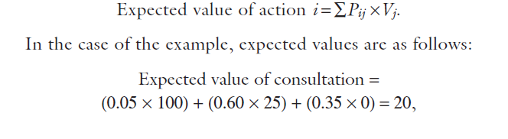
The probability that each action will lead to each outcome is shown
in the six cells of the matrix in Figure 1.4.
The expected value principle says the desirability of each action is the sum of the values of each outcome of the action weighted by the probability
of the outcome.
If Pij is the probability of action i leading to outcome j and
Vj is the value associated with outcome j, then expected value is

Slide 62
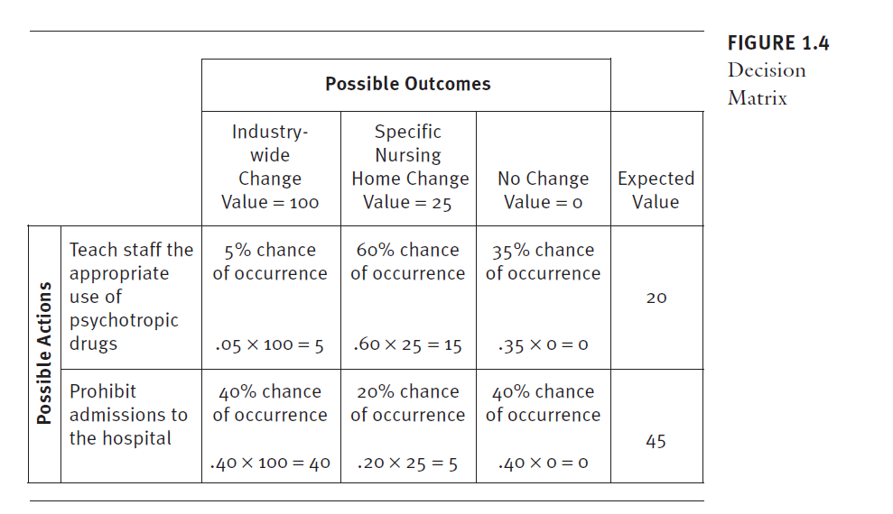


Slide 63
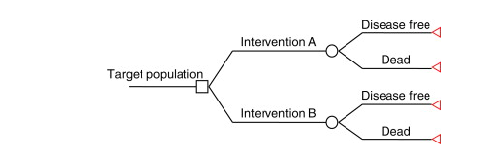

Slide 64
As shown in Figure 1.4, the expected value for teaching staff about
psychotropic drugs is 20, whereas the expected value for prohibiting admissions is 45.
This analysis suggests that the most desirable action would be to prohibit admissions because its expected value is larger than teaching the staff.
In this simple analysis, you see how a mathematical model is used, how uncertainty and values are quantified, and how the model is used to
track ideas and make a picture of the whole for the decision maker.

Slide 65
Step 7: Conduct a Sensitivity Analysis
The analyst interacts with the decision maker to identify how various
assumptions affect the conclusion.
The previous analysis suggests that teaching staff is an inferior decision to prohibiting admissions.
However, this should not be taken at face value because the value and probability estimates might not be accurate. Perhaps the estimates were guesses, or
the estimates were average scores from a group, some of whose members
had little faith in the estimates. In these cases, it would be valuable to
know whether the choice would be affected by using a different set of estimates.
Stated another way, it might make sense to use sensitivity analysis
to determine how much an estimate would have to change to alter the
expected value of the suggested action.

Slide 66
Usually, one estimate is changed until the expected value of the two
choices become the same. Of course, several estimates can also be modified
at once, especially using computers. Sensitivity analysis can be vital not
only to examining the impact of errors in estimation but also to determining
which variables need the most attention.
At each stage in the decision analysis process, it is possible and often
essential to return to an earlier stage to
• add a new action or outcome,
• add new uncertainties,
• refine probability estimates, or
• refine estimates of values.

Slide 67
This cyclical approach offers a better understanding of the problem
and fosters greater confidence in the analysis. Often, the decision recommended
by the analysis is not the one implemented, but the analysis is helpful
because it increases understanding of the issues. Phillips (1984) refers
to this as the theory of requisite decisions: Once all parties agree that the
problem representation is adequate for reaching the decision, the model is
“requisite.”

Slide 68
From this point of view, decision analysis is more an aid to problem
solving than a mathematical technique. Considered in this light, decision
analysis provides the decision maker with a process for thinking about her
actions. It is a practical means for maintaining control of complex decision
problems that involve risk, uncertainty, and multiple objectives (Phillips
1984; Goodwin and Wright 2004).

Slide 69
Step 8: Document and Report Findings
Even though the decision maker has been intimately involved in the analysis
and is probably not surprised at its conclusions, the analysis should document
and report the findings. An analysis has its own life cycle and may
live well beyond the current decision. Individuals not involved in the decision-
making process may question the rationale behind the decision. For
such reasons, it is important to document all considerations that were put
into the analysis. A clear documentation, one that uses multimedia to convey
the issues, would also help create a consensus behind a decision.

Slide 70
Limitations of Decision Analysis
It is difficult to evaluate the effectiveness of decision analysis because often
no information is available on what might have happened if decision makers
had not followed the course of action recommended by the analysis.

Slide 71
One way to improve the accuracy of analysis is to make sure that the process
of analysis is followed faithfully. Rouse and Owen (1998) suggest asking
the following six questions about decision analysis to discern if it was done
accurately:
1. Were all realistic strategies included?
2. Was the appropriate type of model employed?
3. Were all important outcomes considered?
4. Was an explicit and sensible process used to identify, select, and combine
the evidence into probabilities?
5. Were values assigned to outcomes plausible, and were they obtained
in a methodologically acceptable manner?
6. Was the potential impact of any uncertainty in the probability and
value estimates thoroughly and systematically evaluated?

Slide 72
These authors also point out four serious limitations to decision
analysis, which are important to keep in mind:
1. Decision analysis may oversimplify problems to the point that they do
not reflect real concerns or accurately represent the perspective from
which the analysis is being conducted.
2. Available data simply may be inadequate to support the analysis.
3. Value assessment, in particular assessment of quality of life, may be
problematic. Measuring quality of life, while conceptually appealing
and logical, has proven methodologically problematic and philosophically
controversial.
4. Outcomes of decision analyses may not be amenable to traditional
statistical analysis. Strictly, by the tenets of decision analysis, the preferred
strategy or treatment is the one that yields the greatest value
(or maximizes the occurrence of favorable outcomes), no matter how
narrow the margin of improvement.

Slide 73
In the end, the value of decision analysis (with all of its limitations)
is in the eye of the beholder. If the decision maker better understands and
has new insights into a problem, or if the problem and suggested course
of action can be documented and communicated to others more easily,
then a decision maker may judge decision analysis, even an imperfect analysis,
as useful.

Slide 74
Review What You Know
In the following questions, describe a nonclinical work-related decision.
Describe who makes the decision, what actions are possible, what the resulting
outcomes are, and how these outcomes are evaluated:
1. Who makes the decision?
2. What actions are possible (list at least two actions)?
3. What are the possible outcomes?
4. Besides cost, what other values enter these decision?
5. Whose values are considered relevant to the decision?
6. Why are the outcomes uncertain?

Slide 75
Decision analysis relies on the concept of expected values. The expected value of something can be thought of as its average value when it is repeated many times. For example, if a treatment produces a gain of 2 Quality Adjusted Life Years (QALYs) per person in 80% of cases and a gain of 1 QALY per person in the remaining 20%, then out of 100 patients the total gain will be (2x80) + (1x20) = 180. This means that the average gain is 1.8 QALYs per patient, which is the expected value. In reality, it is unlikely that the probabilities of 0.8 and 0.2 would produce exactly 80 and 20 in a population of 100, which is why the assumption of large numbers is made.

Slide 76


